Slide 1

Unit Test – Concept & Pattern
By: Tuan Hoang
Course duration: 4 hours
Last update: Dec 2008

Slide 2
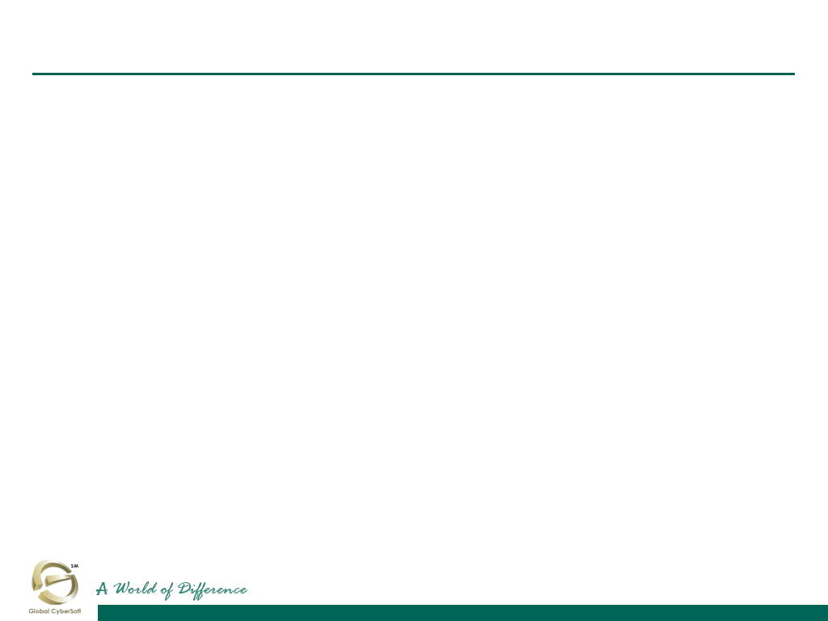

Content
Concept
  Introduction
  Goals of Unit Test
  Philosophy of Unit Test
  Principles of Unit Test
  Test smell
  Unit test types
  Code coverage
  Unit test frameworks
Pattern
  Design-for-Testability Patterns
    Dependency Injection
    Dependency Lookup
    Humble Object
    Test Hook
  Simple-Test-Data Pattern
  Test Double Patterns
  Database Patterns
    Database Sandbox
    Stored Procedure Test
    Transaction Rollback Teardown

Slide 3
Content by Staff Level
For 1-year engineer (junior engineer)
  Concept
    Introduction
    Goals of Unit Test
    Philosophy of Unit Test
    Principles of Unit Test
    Unit test types
    Code coverage
    Unit test frameworks
For 3-year engineer (lead engineer)
  Concept
    Test smell
  Pattern
    Design-for-Testability Patterns
    Simple-Test-Data Pattern
    Test Double Patterns
    Database Patterns

Slide 4
Section #1
Concept
Introduction
Goals of Unit Test
Philosophy of Unit Test
Principles of Unit Test
Test smell
Unit test types
Code coverage
Unit test frameworks

Slide 5
Introduction
Unit testing is a set of activities that take the smallest piece of testable software in the application (unit of work), isolate it from the remainder of the code, and determine whether it behaves exactly as you expect.
Over time, usage of the term unit test broadened. For example, IEEE has defined unit testing as “Testing of individual hardware or software units or groups of related units” (emphasis added) ^{[16]}.

Slide 6
Unit Test vs Integration Test vs System test
A unit test examines the behavior of a distinct unit of work. Within a Java application, the “distinct unit of work” is often (but not always) a single method. A unit of work is a task that is not directly dependent on the completion of any other task ^{[15]}.
By contrast, integration test examine how various components interact
System testing tests a completely integrated system to verify that it meets its requirements

Slide 7
How GCS staff understand about unit testing?
Many PM assign task to developer with the schedule: 5 day for coding, 3 days for unit testing. “Unit testing” here imply that Dev add debug code to test each function, method run correctly (do not apply any unit test framework) and further more, make sure the assigned modules run correctly (no bugs).
When audit project, a QA ask Dev: Could you show me some evidence that you had done the UT and How you did it?
Dev open a source file and said that: When I write this function, I always test it with debug input data, check output by print it to screen, if the output match my design output, it pass. So I did Unit Test.
In a project of a Japanese client have some bugs related to SQL, client complain GCS PM that “Have your team done unit test?”. But they even never know about Unit test tools.
Guys in above stories think Unit Testing is test functions by debugging, some one think that unit testing also verify your modules, functionality that it meets user requirements
The above understand is right or wrong? It can make a long argue.
In most of internet article about unit test and in this document: Unit test is understood as automation unit testing.

Slide 8
Do we need Unit Test?
Unit testing has proven its value in that a large percentage of defects are identified during its use.
But many developers get very nervous when you mention unit tests:
  I don’t know how to test it.
  I don’t really know what it is supposed to do, so I can’t test it.
  I’m not a tester, with me writing UT as “coding of the tests”.

Slide 9
Definitions, and Abbreviations
SUT: Software Under Test
DOC: Dependent-On Component
Test case: a method that defines a set of inputs and expected outputs for a testing functions.
Test suites: a set of tests that all share the same fixture.
Test Fixtures: a set of preconditions or state needed for a test to run. Also known as a test context.
Test harness: a collection of software and test data configured to test a program unit by running it under varying conditions and monitor its behavior and outputs. It has two main parts: the test execution engine and the test script repository.

Slide 10
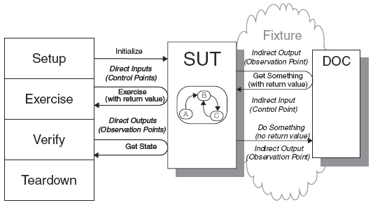
Unit Testing – Common Approaching
The most common approach to unit testing is automation testing which requires drivers and stubs to be written. The driver simulates a calling unit and the stub simulates a called unit.

Slide 11
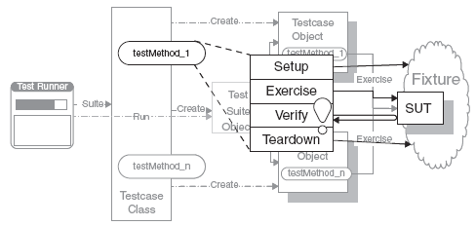
Unit Testing – Common Approaching
Setup: set up the test fixture that is required for the SUT to exhibit the expected behavior as well as anything you need to put in place to be able to observe the actual outcome
Verify: do whatever is necessary to determine whether the expected outcome has been obtained
Teardown: tear down the test fixture to put the world back into the initial state
Exercise: interact with the SUT

Slide 12
Sample of unit test code
import junit.framework.TestCase;
public class ShoppingCartTest extends TestCase {
private ShoppingCart cart;
private Product book1;
/**
* Sets up the test fixture.
*
* Called before every test case method.
*/
protected void setUp() {
cart = new ShoppingCart();
book1 = new Product("Pragmatic Unit Testing", 29.95);
cart.addItem(book1);
}
/**
* Tears down the test fixture.
*
* Called after every test case method.
*/
protected void tearDown() {
// release objects under test here, if necessary
}
/**
* Tests emptying the cart.
*/
public void testEmpty() {
cart.empty();
assertEquals(0, cart.getItemCount());
}
/**
* Tests removing an unknown item from the cart.
*
* This test is successful if the
* ProductNotFoundException is raised.
*/
public void testRemoveItemNotInCart() {
try {
Product book3 = new Product("Pragmatic Ver Control", 29.95);
cart.removeItem(book3);
fail("Should raise a ProductNotFoundException");
} catch(ProductNotFoundException expected) {
// successful test
}
}
}

Slide 13

Unit test types
There are 2 types of unit testing:
  White-box testing
  Black-box testing

Slide 14
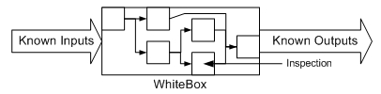
Unit test types – White box testing
A white box provides the information necessary to test all the possible pathways. This includes not only correct inputs, but incorrect inputs, so that error handlers can be verified as well.
  You know how the box handles errors.
  You can usually write tests that verify all code pathways.
  The unit test, being more complete, is a kind of documentation guideline that the implementer can use when actually writing the code in the box.
  Resource dependencies are known.
  Internal workings can be inspected.

Slide 15
Unit test types – Black box testing
A black box test (also known as "functional test") is one in which you feed it inputs and verify the outputs without being able to inspect the internal workings.
Furthermore, one doesn't usually have information regarding:
  how the box handles errors
  whether your inputs are executing all code pathways
  how to modify your inputs so that all code pathways are executed
  dependencies on other resources
Black box testing limits your ability to thoroughly test the code, primarily because you don't know if you're testing all the code pathways. Typically, a black box test only verifies that good inputs result in good outputs.
???
Known inputs
Known outputs

Slide 16
White box testing - Code coverage
Code coverage is a measure used in software testing. It describes the degree to which the source code of a program has been tested. It is expressed as percentage.
It is a form of testing that looks at the code directly -> white box testing.
There are a number of different ways of measuring code coverage:
  Statement Coverage - Has each line of the source code been executed and tested?
  Condition Coverage - Has each evaluation point (such as a true/false decision) been executed and tested?
  Path Coverage - Has every possible route through a given part of the code been executed and tested?
  Entry/Exit Coverage - Has every possible call and return of the function been executed and tested?

Slide 17

Effective Unit Test
Tests should help us improve quality
Tests should help us understand the SUT
Tests should reduce (and not introduce) risk
Tests should be easy to run
Tests should be easy to write and maintain
Tests should require minimal maintenance as the system evolves around them

Slide 18
Philosophy of Unit Test
Test First or Last?
  Even if we design for testability, the likelihood that we can write the tests easily and naturally without modifying the production code is low
  When tests are written first and we write only enough code to make the tests pass, the production code tends to be more minimalist
Outside-In or Inside-Out?
  Inside-Out: Development starts with the innermost components and proceeds toward the user interface, building on the previously constructed components
  OutSide-In: Development starts at the outside using Test Doubles in place of the depended-on components (DOCs) and proceeds inward as requirements for each DOC are identified

Slide 19
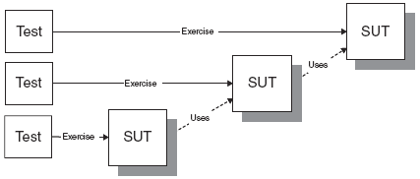
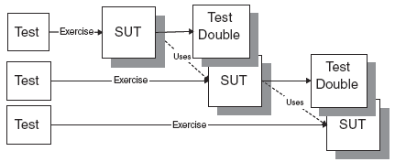
Philosophy of Unit Test (cont)
Inside-Out
OutSide-In

Slide 20
Principles of Unit Test
Isolate the SUT
  The SUT may depend on many other parts, this principal requires that the SUT must be isolated as much as possible the SUT from all the other parts of the software
Minimize Test Overlap
Minimize Un-testable Code
Keep Test Logic Out of Production Code
Verify One Condition per Test
Ensure Commensurate Effort and Responsibility
  The amount of effort it takes to write or modify tests should not exceed the effort it takes to implement the corresponding functionality.

Slide 21
Test Smells
Hard-to-Test Code
  Code is difficult to test.
Production Bugs
  We find too many bugs during formal test or in production.
Fragile Test
  A test fails to compile or run when the SUT is changed in ways that do not affect the part the test is exercising.
Test Code Duplication
  The same test code is repeated many times.
Test Logic in Production
  The code that is put into production contains logic that should be exercised only during tests.
Erratic Test
  One or more tests are behaving erratically; sometimes they pass and sometimes they fail.

Slide 22
Test Smells (cont)
Obscure Test
  It is difficult to understand the test at a glance.
Assertion Roulette
  It is hard to tell which of several assertions within the same test method caused a test failure.
Conditional Test Logic
  A test contains code that may or may not be executed.
Slow Tests
  The tests take too long to run.
Developers Not Writing Tests
  Developers aren't writing unit tests.

Slide 23
Unit test frameworks
Unit test frameworks help simplify the process of unit testing, have been developed for a wide variety of language.
Unit test frameworks provides:
  Base classes for creating test case, test suite.
  Support for creating mock objects.
  Assertion statements that are used to test your code.
  An easy way for executing unit test as well as outputting the test result.

Slide 24
Unit test frameworks (cont)
AdaTEST 95
Aunit
C++Test
Cantata++
Check
COMPUTE
CppUnit
csUnit
CTA++
CUnit
CUT
dotunit
DUnit
EasyMock
GJTester
GrandTestAuto
HarnessIt
HtmlUnit
HttpUnit
JavaScript Assertion Unit (jsAsserUnit)
JsUnit (Hieatt)
JsUnit (Schaible)
JTestCase
JUnit
JUnitEE
JUnitX
LingoUnit
MinUnit
Mock Creator
Mock Objects
MockMaker
mockpp
Mockry
NUnit
ObjcUnit
OCUnit
PalmUnit
PBUnit
Perl Test::MockObject
PerlUnit
phpAsserUnit
PhpUnit
PyUnit
QtUnit
Rational Test RealTime Unit Testing
Ruby/Mock
Ruby Test::Unit
SimpleTest
SUnit
TagUnit
TBrun
Tessy
.TEST
Test Mentor - Java Edition
TestGen4J
unit++
vbUnit3 Basic
VectorCAST
xmlMessageTest
XMLUnit
XSLTunit

Slide 25
Discussion
UT takes too much time?
How many UT are enough: Write one assertion per test?
🡺 What do you think?

Slide 26
Section #2
Pattern
Design-for-Testability Patterns
  Dependency Injection
  Dependency Lookup
  Humble Object
  Test Hook
Simple-Test-Data Pattern
Test Double Patterns
Database Patterns
  Database Sandbox
  Stored Procedure Test
  Transaction Rollback Teardown

Slide 27
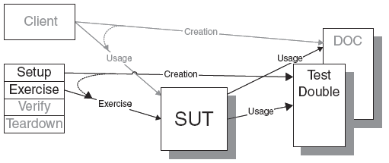
Dependency Injection
Question: How do we design the SUT so that we can replace its dependencies at runtime?
Answer: The client provides the depended-on object to the SUT
Implementations
  Separation of interface from implementation
  Create Test Doubles
  Installing the Test Double
    Parameter Injection
    Constructor Injection
    Setter Injection

Slide 28
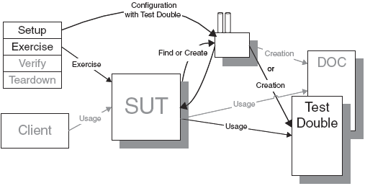
Dependency Lookup
Question: How do we design the SUT so that we can replace its dependencies at runtime?
Answer: The SUT asks another object to return the depended-on object before it uses it

Slide 29
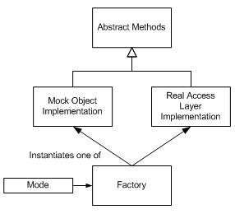
Dependency Lookup (cont)
Implementations
  Either a Singleton, a Registry, or some kind of Thread-Specific Storage
  An interface that fully encapsulates which implementation we are using
  A built-in substitution mechanism for replacing the returned object with a Test Double
  Access via well-known global name
  Factory objects

Slide 30
Humble Object
Question: How can we make code testable when it is too closely coupled to its environment?
  We are often faced with trying to test software that is closely coupled to some kind of framework. Examples include visual components (e.g., widgets, dialogs) and transactional component plug-ins. Testing these objects is difficult because constructing all the objects with which our SUT needs to interact may be expensive—or even impossible. In other cases, objects may be hard to test because they run asynchronously; examples include active objects (e.g., threads, processes, Web servers) and user interfaces. These objects’ asynchronicity introduces uncertainty, a requirement for inter-process coordination, and the need for delays into tests

Slide 31
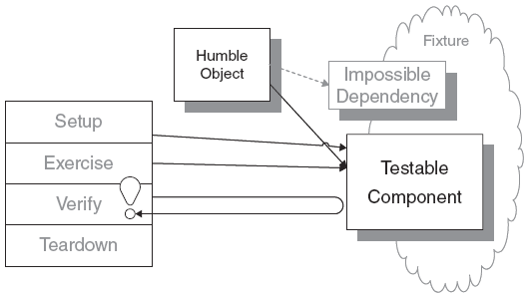
Humble Object (cont)
Answer: We extract the logic into a separate, easy-to-test component that is decoupled from its environment
Implementations
  Humble Executable (Threading): The Humble Executable component itself contains very little code. All it does in its thread of control is to load the testable component (if a True Humble Object) and delegate to it

Slide 32
Humble Object (cont)
Implementations (cont)
  Humble Dialog (GUI): Using a Humble Object to move all of the controller and view-updating logic out of the framework-dependent object and into a testable object
  Humble Transaction Controller (DB): Use an Extract Method refactoring to move all the logic we want to test out of the code that controls the transaction and into a separate method that knows nothing about transaction control and that can be called by the test
  Humble Container Adapter (Ex: EJB Container): Design our objects to be container-independent and then have a Humble Container Adapter adapt them to the interface required by container

Slide 33
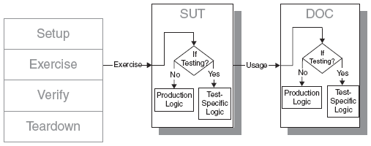
Test Hook
Question: How do we design the SUT so that we can replace its dependencies at runtime?
Answer: We modify the SUT to behave differently during the test
Note:
  Test Hook is a “method of last resort” for introducing test-specific behavior during automated testing

Slide 34
Section #3
Simple-Test-Data Pattern

Slide 35
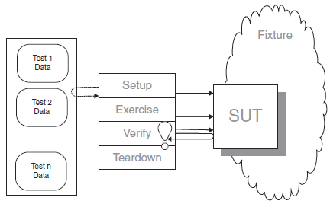
Simple-Test-Data Pattern
Question:
  How do we prepare automated tests for our software?
  How do we reduce Test Code Duplication?
Answer: We store all the information needed for each test in a data file and write an interpreter that reads the file and executes the tests.

Slide 36
Section #4
Test Double

Slide 37
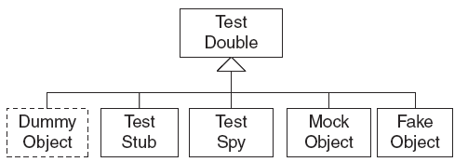
Test Double
Dummy Object: Some method signatures of the SUT may require objects as parameters. If neither the test nor the SUT cares about these objects, we may choose to pass in a Dummy Object
Test Stub: replace a real component on which the SUT depends so that the test has a control point for the indirect inputs of the SUT
Test Spy: Like a Test Stub, a Test Spy may need to provide values to the SUT in response to method calls. The Test Spy, however, also captures the indirect outputs of the SUT as it is exercised and saves them for later verification by the test
Mock Object: Typically, the Mock Object also includes the functionality of a Test Stub in that it must return values to the SUT if it hasn’t already failed the tests but the emphasis is on the verification of the indirect outputs
Fake Object: implements the same functionality as the real DOC but in a much simpler way (is not used to verify indirect input and output)

Slide 38
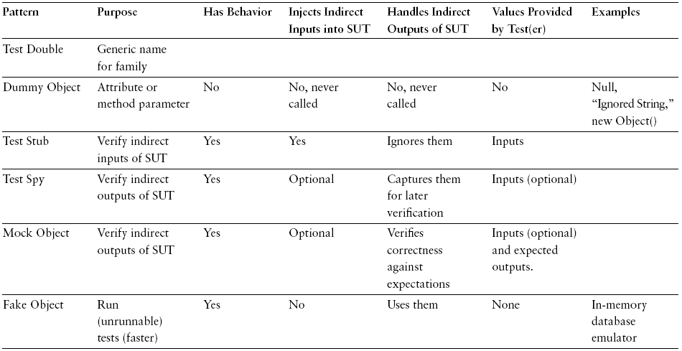
Test Double (cont)

Slide 39
Section #5
Database Patterns
Database Sandbox
Stored Procedure Test
Transaction Rollback Teardown

Slide 40
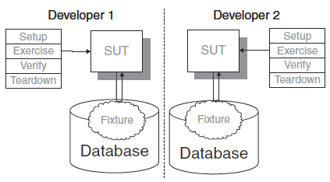
Database Sandbox
Question: How do we develop and test software that depends on a database?
Answer: We provide a separate test database for each developer or tester.
Note:
  We should use a Database Sandbox whenever we are building or modifying an application that depends on a database for a significant portion of its functionality.

Slide 41
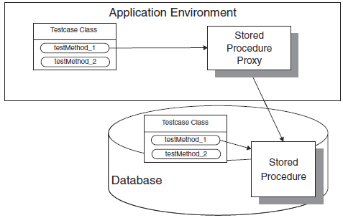
Stored Procedure Test
Question: How can we verify logic independently when we have stored procedures?
Answer: We write Fully Automated Tests for each stored procedure.
Note:
  We can write the tests in the same programming language as the stored procedure and run them in the database
  We can write the tests in our application programming language and access the stored procedure via a Remote Proxy

Slide 42
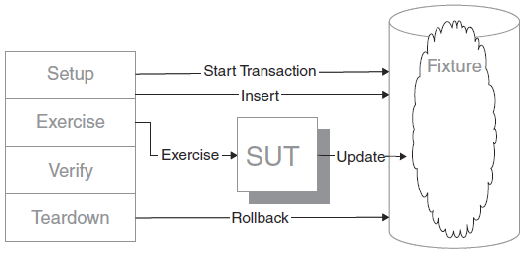
Transaction Rollback Teardown
Question: How do we tear down the Test Fixture when it is in a relational database?
Answer: We roll back the uncommitted test transaction as part of the teardown.
Note:
  the SUT must expose methods that are normally called in the context of an existing transaction, that is, the methods should not start their own transaction and must never commit a transaction

Slide 43

Question and Answer

Slide 44
Appendix: Course detail form
Author
Tuan Hoang
Duration
4 hours
Category
Software Engineering
Type
Theory / Theory and Practice
Examination | Review questions / quiz will be at the end of the course. The purpose is to review the awareness of all attendees on some important points of this course.
Intended Audience | Any software technician, engineer, project leader, project manager, manager who are working in software related projects.
Pre-requisites | Those who have basic knowledge of software development life cycle, programming language and design pattern.
Completion criteria for the course | Attendee must join at least 80% of course length and finish the review questions section with score rate of 75% or higher.
Criteria for granting training waivers | Those who has experience on unit testing, or already attended similar courses.

